Slide 1
Welcome!
8/30 (A); 8/31 (B)

Slide 2
Remainder of Stations

Slide 3
Syllabus/Class Procedures

Slide 4
Book Clubs!
Every nine weeks, you will be asked to read a text with your group. You have until September 14th (A) or September 15th (B) to procure your first chosen text.

Slide 5
Me Talk Pretty one day, David Sedaris
2000, Essay Collection
A collection of (usually) comedic essays, told as a memoir. Told in two parts.

Slide 6
Being There, Jerzy Kosinski
1970, Satirical Fiction
A simple gardener unwittingly becomes a sought-after political pundit and international celebrity.

Slide 7
The Curious Incident of a Dog in the Night Time, Mark Haddon
2003, Mystery
A teenager with savant syndrome sets out to solve the mystery of his neighbor’s murdered dog, and uncovers a number of other mysteries along the way…

Slide 8
I Know Why the Caged Bird Sings, Maya Angelou
1969, Autobiography/Bildungsroman
Maya Angelou’s retelling of her own childhood in Stamps, Alabama. Broadly a story of how she overcomes racism through strength of character.
TW: Rape

Slide 9
Cloud Atlas, David Mitchell
2004, Sci-Fi/Fantasy
Six nested stories, each of which is interrupted at a pivotal moment. Spans nineteenth century to a distant post-apocalyptic future, where all but one protagonist is a reincarnation of the same character.

Slide 10
Snow Flower and the Secret Fan, Lisa See
2005, Semi-Historical Novel
Set in 19th century rural China, it follows the story of two laotong, bonded sisters for life. Explores feudal Chinese society, particularly women’s roles and class struggles.

Slide 11
Book Club Sign ups – Please Use Google Forms
Remind 101: https://goo.gl/forms/L62C8f3udv15Y1233

Slide 12
Writer’s Notebooks
Epigraph
Mrs. Tombs’s selection: “When the snows fall and the white winds blow, the lone wolf dies, but the pack survives.” –George R. R. Martin
Table of Contents
Table of Contents
Number the first 30 pages of your Writer’s Notebook, starting with 1 after the Table of Contents. Do not number the backs of pages- you will use these for your Alpha Notes.

Slide 13
Writing Inventory
TOC: Page 1 – Writing Inventory
This is simply a list of things you can write about. Your hobbies, interests, passions… Whenever you get stuck and tell your teacher you don’t know what to write about, flip back to page 1 of your Writer’s Notebook!
Add to this list throughout the year.
Examples: Football, anime, Minecraft, politics, Panic! at the Disco, your job, your family, mudding, make up…

Slide 14
Alpha Notes
Today you will take notes on annotation in your writer’s notebooks. Next class, we will be writing corresponding questions and summaries on the back pages of your notes. In the future, you will be doing this at home, and I will occasionally spot check to make sure they are done. But for the first time, I will show you how to do the follow-up activities in class.

Slide 15
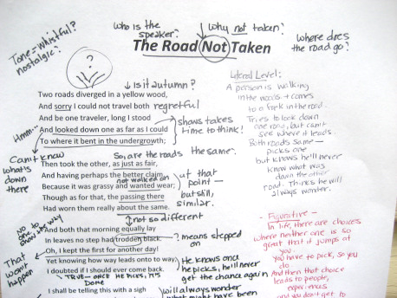
Awesome Annotations
TOC: Page 2 – Annotation Strategies
Annotation is all about active reading. You are interacting with the text, not just looking at it!

Slide 16
Pre-AP Annotation
Read first and last sentence
Circle main nouns
Write the main idea next to each paragraph
Identify shifts
Decide if the passage is positive or negative

Slide 17
Helpful strategies First read
Circle the main nouns
? Any confusing diction
Define any new words and write a synonym in the margins
Emotional language
* Anything interesting

Slide 18
Helpful Strategies Second Read
Figurative Language
Identify in margin
Imagery
Syntax
Tone
In the margin- use your tone wheel
*Add comments to interesting passages

Slide 19
Mock AP Test

